Slide 1
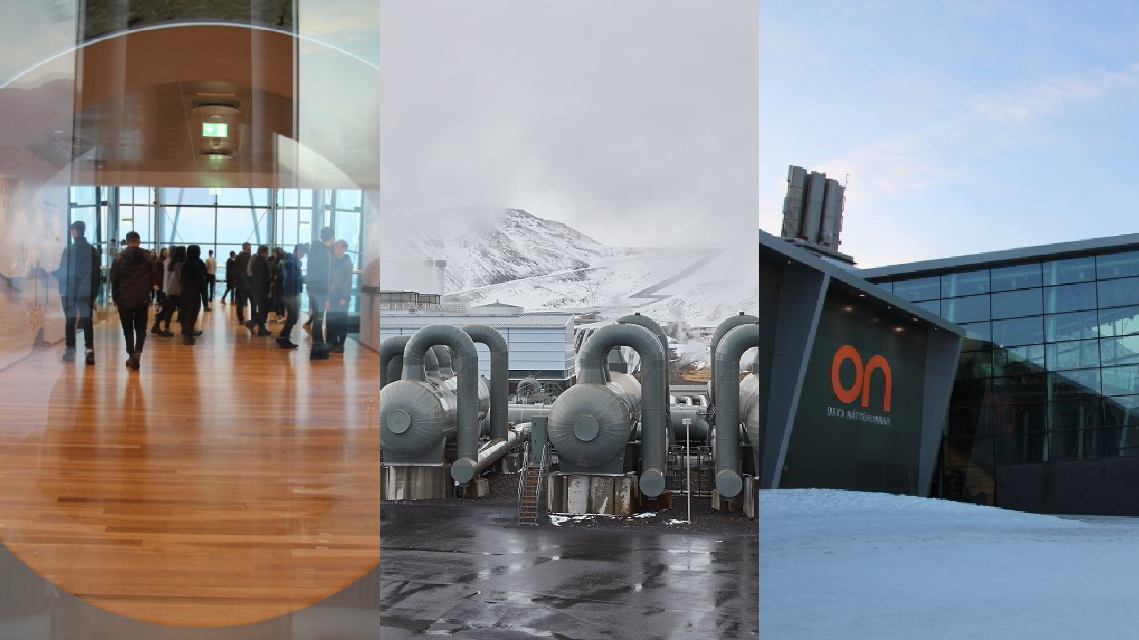

RESOURCE MANAGEMENT ENERGY
Hellisheidi Power Plant
The Hellisheidi power plant summary
The Hellisheidi power plant is the sixth largest geothermal power plant in the World by installed capacity. It is a flash steam combined heat and power plant (CHP) generating 303MW of electricity and 400MW of thermal energy.
Why has there been an increase in energy consumption?
Economic development means an increase in demand for energy.
Increase in population and need for agriculture, industry, transport, urbanisation and recreation.
New and modern technology requires more energy.
What are fossil fuels? Give examples.
A fossil fuel is a fuel formed by natural processes. Decomposition of buried dead organisms, which contain organic matter.
Coal
Oil
Gas
What is a natural resource?
Natural resources are materials or substances that are created by the environment. Humans use natural resources to survive and or economic gain.
What factors affect energy availability?
Physical factors such as the weather and climate, geology, altitude and landlocked.
Economic factors such as cost of exploitation, technology, transportation and infrastructure.
Political factors such as governance, trade blocks and conflict.
How does geothermal energy work in Iceland?
Geothermal water is used to heat around 90% of Iceland's homes. Hot water from the springs is cooled and pumped straight into the taps of nearby homes, stopping the need for hot water heating. The steam from the hot springs rotate turbines that activates a generator, which produces electricity.
What is the difference between a renewable and non-renewable energy supply?
Renewable energy sources are those which will
not run out and can be used over again. E.G wind, tidal and solar energy. Non-renewable energy sources can only be used once. E.G Oil and coal.
What strategies can be used to increase energy supply?
Non-renewable fossil fuels. Exploiting current reserves. Using technology to find new reserves.
Develop renewable energy sources which are more sustainable.

