Slide 1
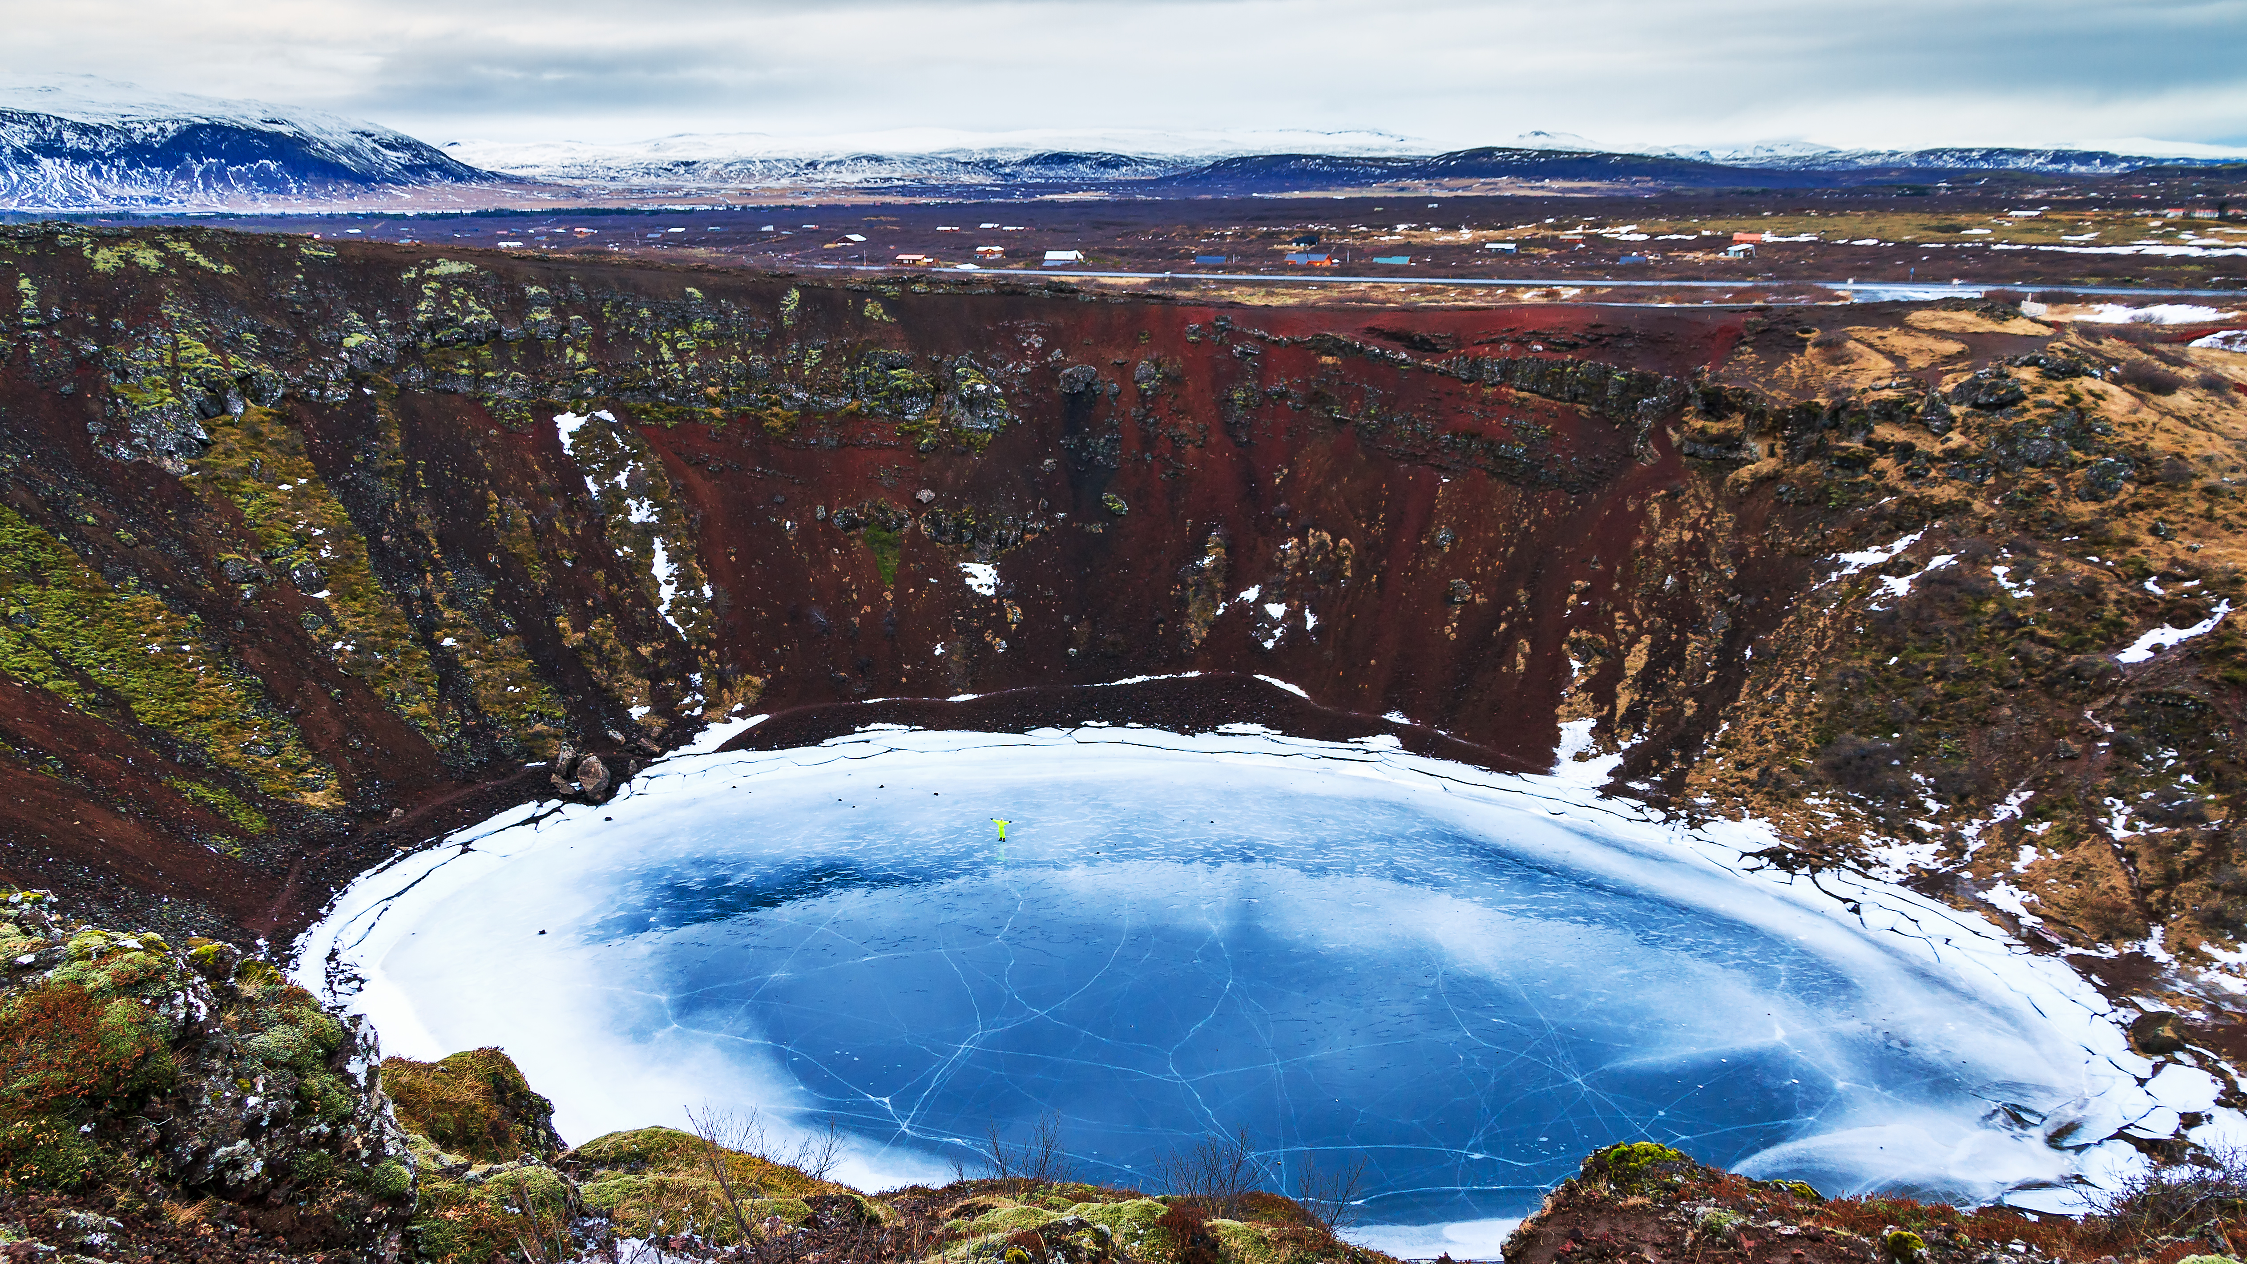

THE CHALLENGE OF NATURAL HAZARDS
Tectonics and Resources - Kerid Volcanic crater
List the possible impacts of a volcanic eruption.
Deaths and injuries, floods, mudslides, power outages, drinking water contamination, wildfires, crops and farmland damaged, collapsed buildings.
Identify the different shapes of volcanoes.
Cone
Shield
Composite
What type of volcano is Kerid?
Kerid Volcanic crater believed to be a cone volcano that erupted and emptied its magma reserve. Kerid crater lake is a 3,000 year old volcanic crater lake in South Iceland. The lake has a depth of 7 and 14 metres depending on rainfall.
Draw a labelled diagram of a volcanoes structure.
How was Kerid volcano created?
Kerid volcano was created on Iceland's constructive boundary, as the Eurasian and North American plates move apart, allowing magma to rise between the lava fissures.
Short term immediate responses to a volcanic eruption.
Issuing warnings, rescue teams searching for survivors, providing treatment to injured people, food, drink and shelter provided, bodies recovered and fires extinguished.
Identify volcanic hazards.
Lava flow
Ash Cloud
Acid rain
Pyroclastic Flow
Lahars
Volcanic bombs
Earthquakes
Landslides
Describe how volcanoes can be managed as a long term response.
Predict – Boreholes, tiltmeters, seismometers, lasers. Protect – Concrete shelters, Lahar channels,
Prepare – Emergency services, practice drills, education, evacuation routes, emergency plans.

