Slide 1
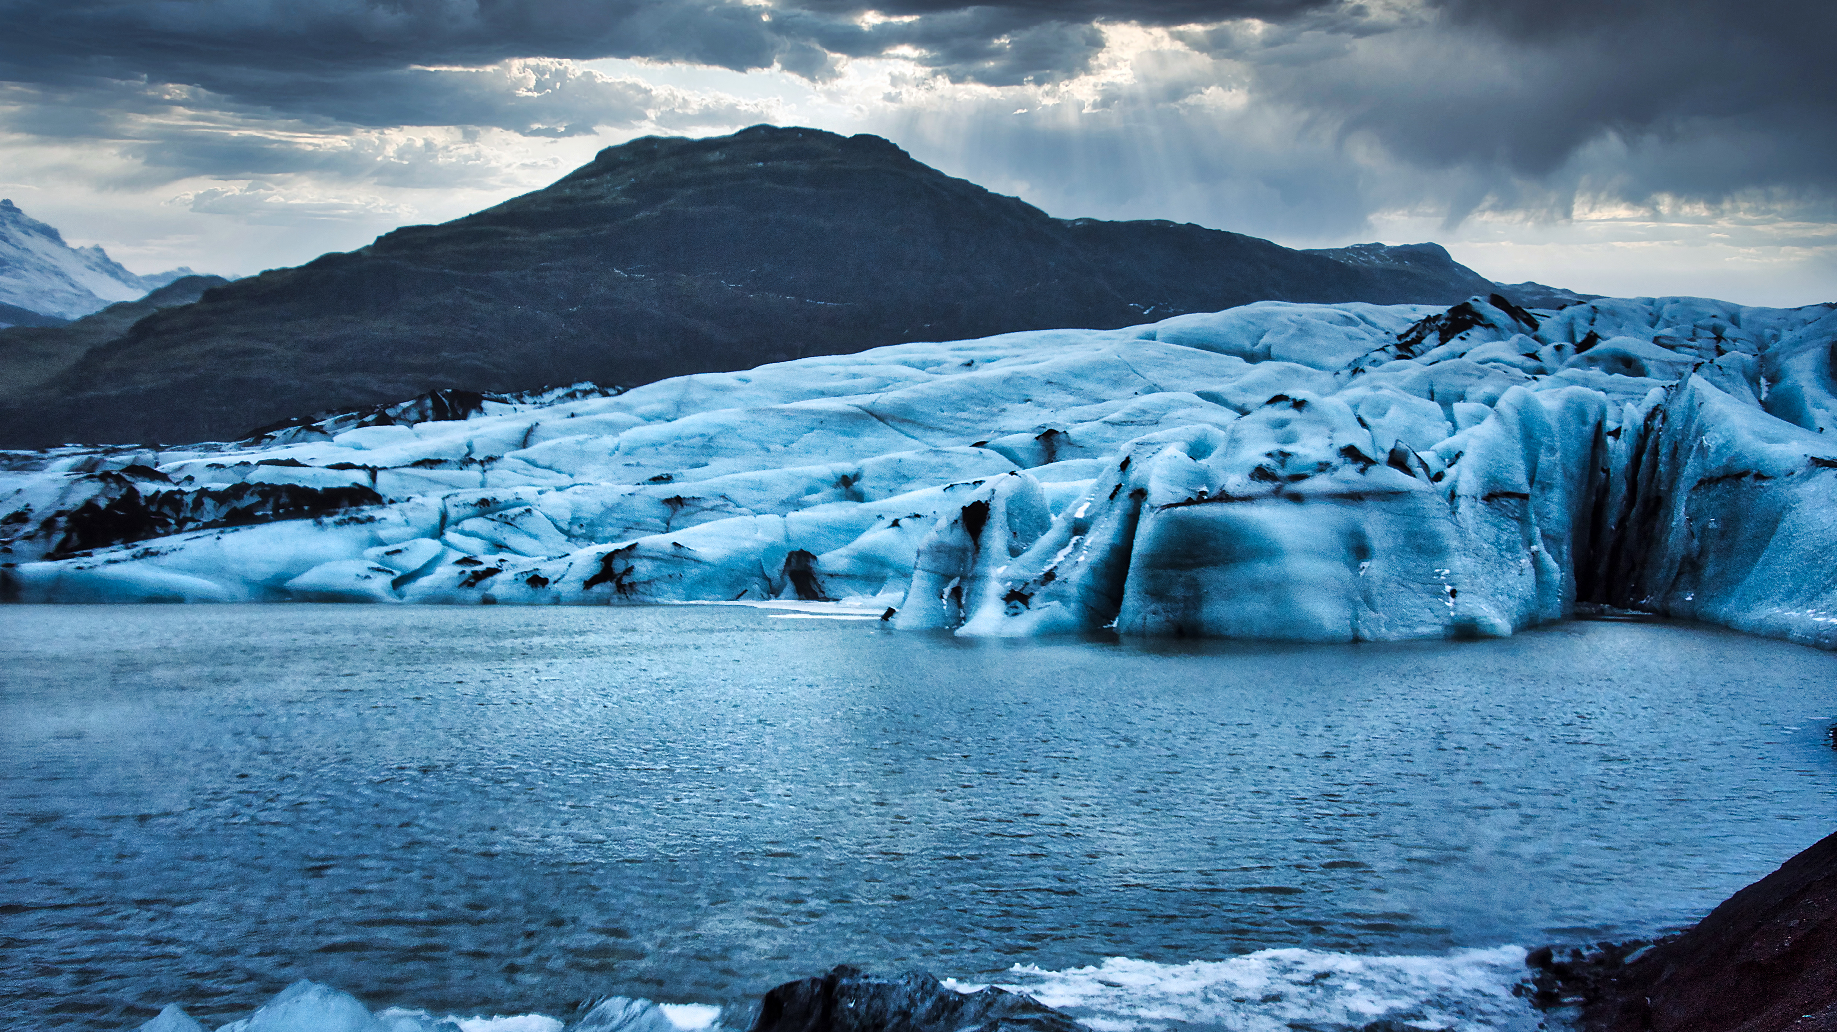
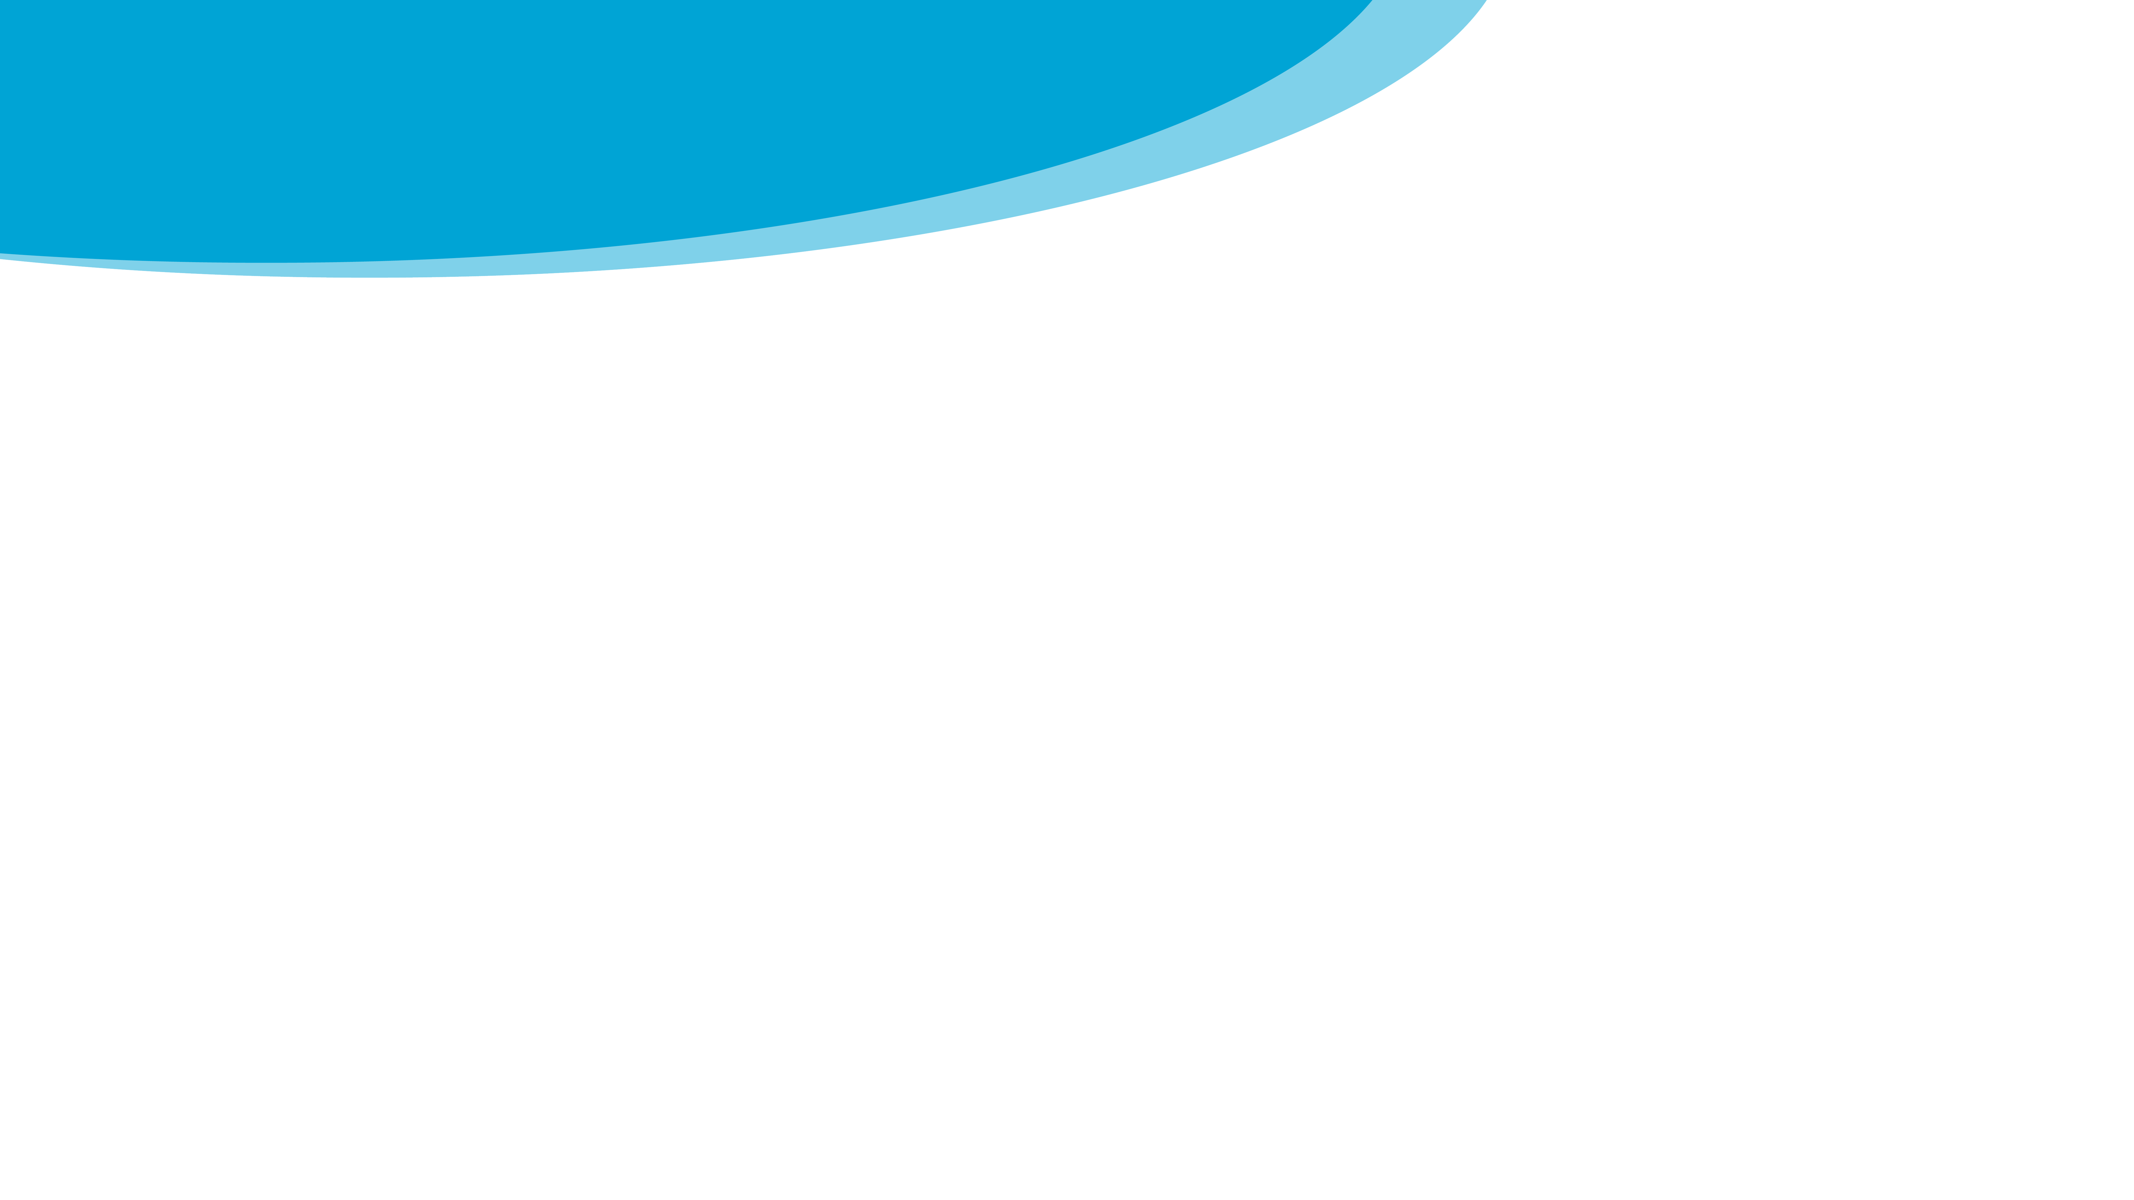
PHYSICAL LANDSCAPES GLACIERS
Sólheimajökull
Describe the different types of glacial erosion.
Plucking - meltwater freezes around loose rock, then as the glacier moves it pulls the rocks away.
Abrasion - rocks frozen to the glacier scrape away the bedrock below.
Describe freeze-thaw weathering.
Water enters cracks in the rock, which then freezes and expands. This causes the crack to become larger and eventually breaks off chunks of the rocks.
What are the possible impacts of glacial retreat?
Opportunities – Mining, quarrying and mineral extraction. Increase in vegetation and biodiversity.
Disadvantages – Increase risk of flooding, avalanches, sea level change, impacts on tourism.
Describe the location of the Sólheimajökull glacier.
Sólheimajökull is located in southern Iceland, between the volcanoes Katla and Eyjafjallajökull. Sólheimajökull is an outlet glacier from Mýrdalsjökull, Iceland's fourth largest glacier.
Identify landforms of glacial erosion.
Corrie, u-shaped valley, arête, hanging valley, pyramidal peak and truncated spur.
What evidence of glacial retreat is seen at Sólheimajökull?
Sólheimajökull is retreating at a rapid pace, causing suggesting the glacier will disappear in the near future. The glacier is retreating 65 m (213 ft) every year over the past couple of decades.
Describe the types of accumulation and ablation.
Zone of accumulation is at the upper section of the glacier, where snow is added via snow fall and or avalanches. Ablation is at the lower section of the glacier, where ice melts and breaks off.
Identify landforms resulting from glacial transportation and deposition.
Drumlins, erratic's and moraine (lateral, medial, terminal and ground moraine).

