Slide 1
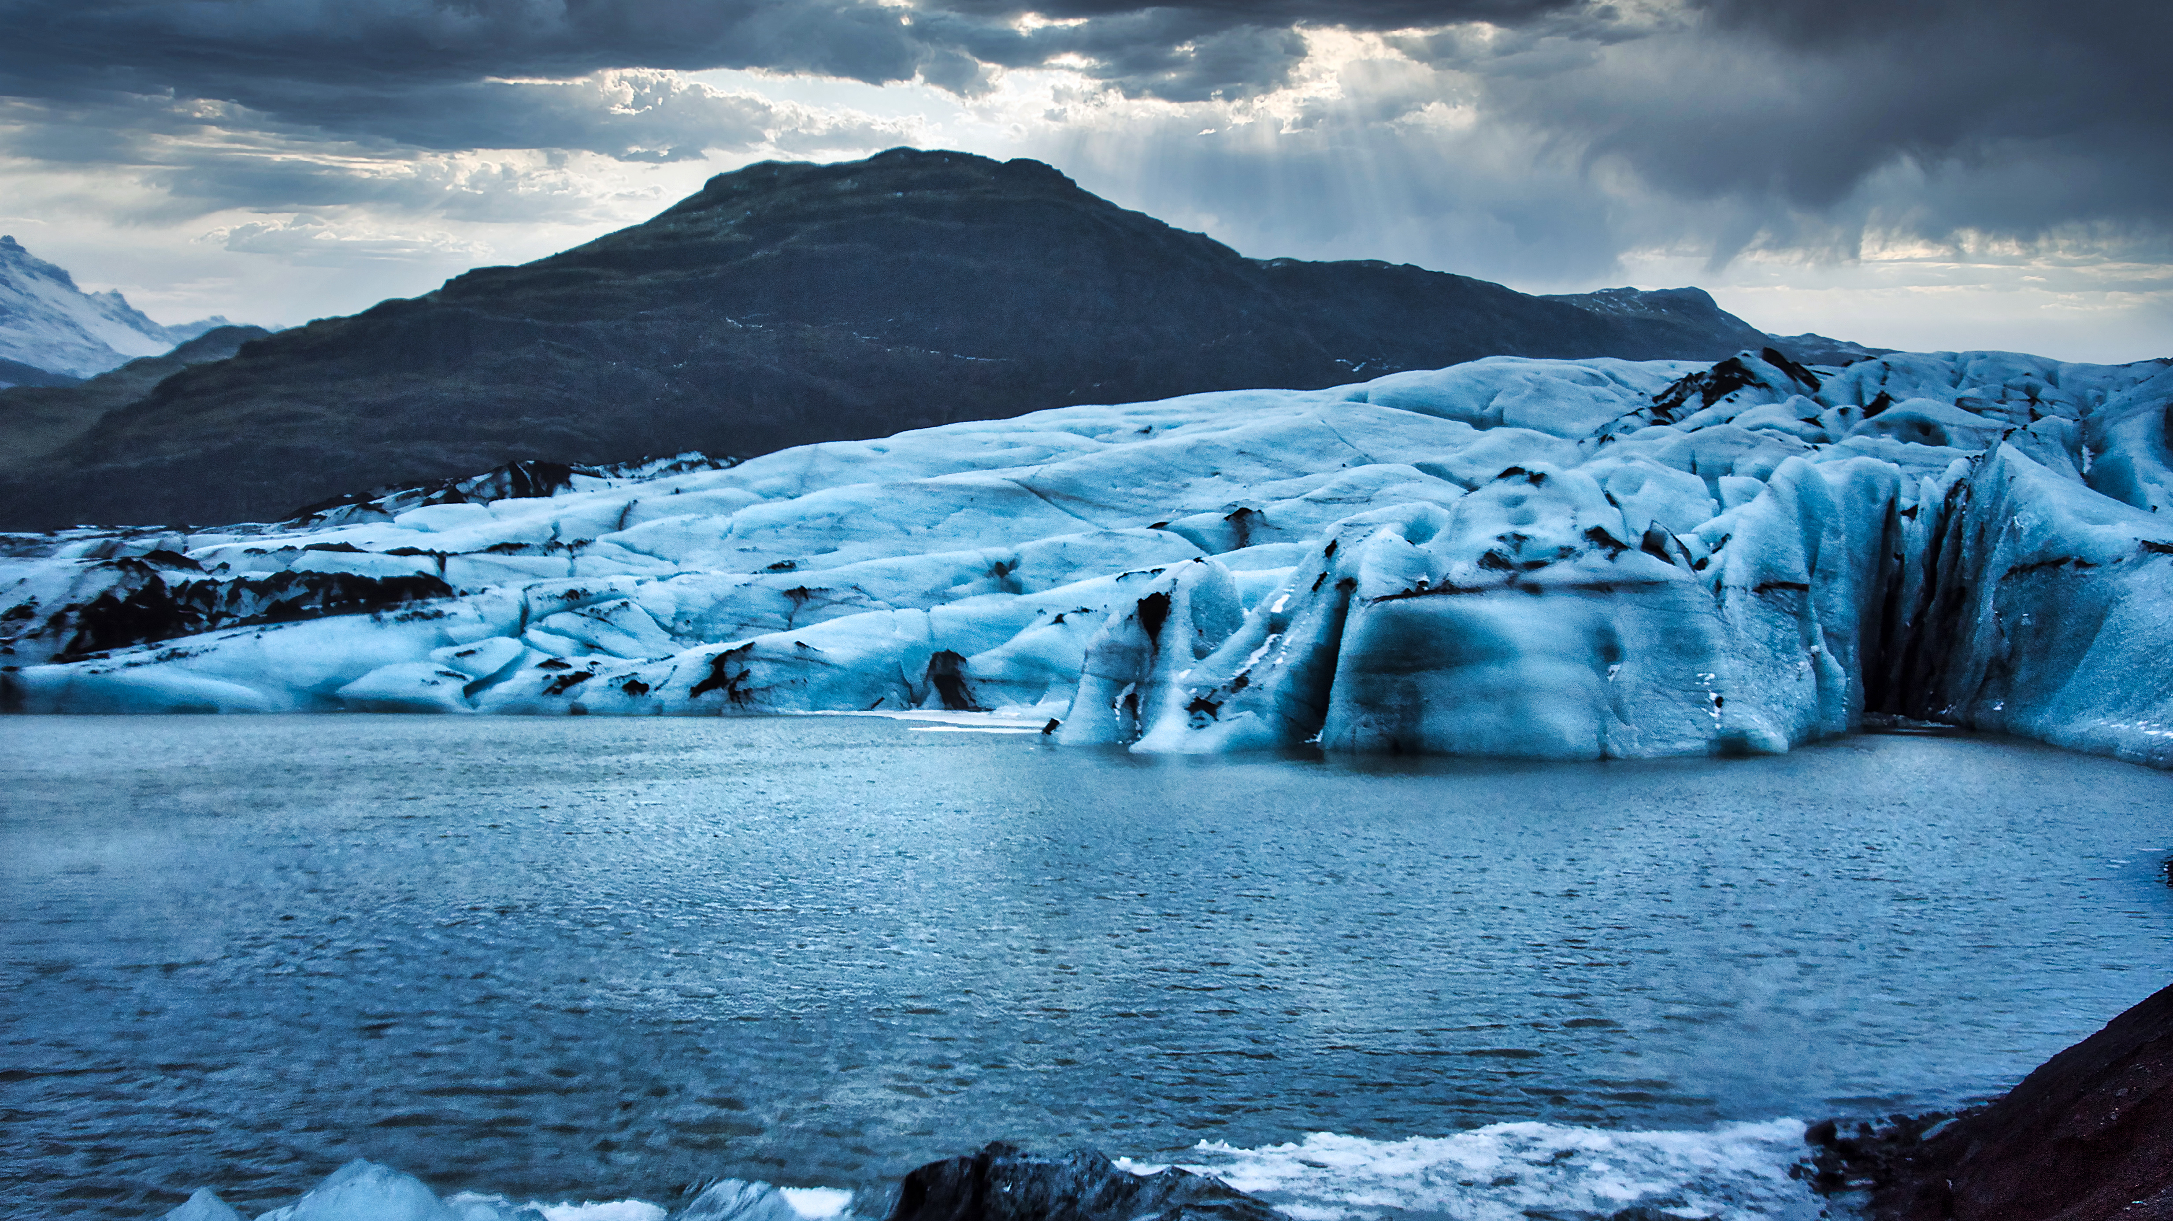

PHYSICAL LANDSCAPES GLACIERS
Sólheimajökull
Describe the different types of glacial erosion.
Describe freeze-thaw weathering.
What are the possible impacts of glacial retreat?
Describe the location of the Sólheimajökull glacier.
Identify landforms of glacial erosion.
What evidence of glacial retreat is seen at Sólheimajökull?
Describe the types of accumulation and ablation.
Identify landforms resulting from glacial transportation and deposition.

