Slide 1

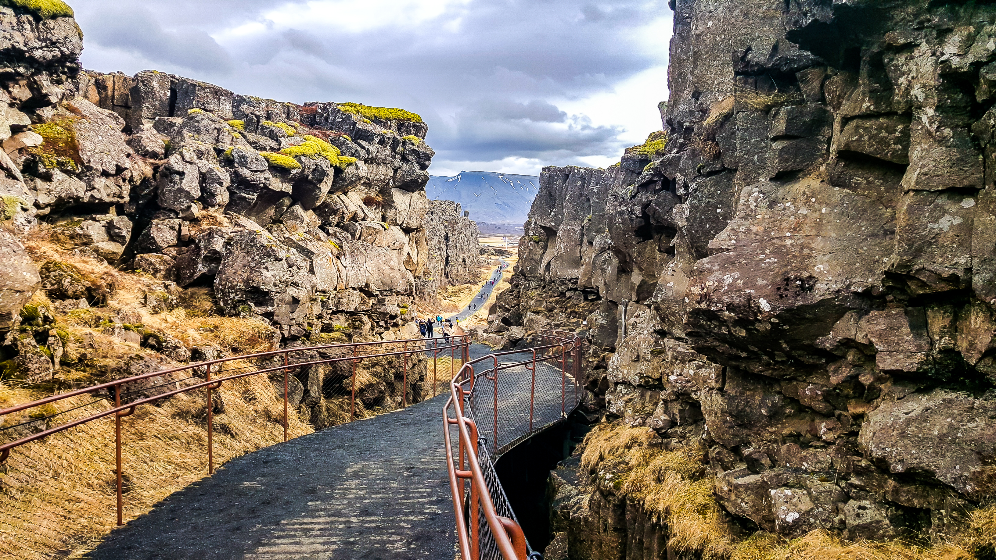
THE CHALLENGE OF NATURAL HAZARDS
Tectonics and Resources - Thingvellir National Park
Why is Thingvellir important?
Thingvellir National Park is a designated UNESCO World Heritage site because this is the site of the world's oldest existing parliament and the birthplace of Iceland the country. It is also significant geological important due to it being the site where two tectonic plates are moving apart.
Why do tectonic plates move?
The breakdown of radioactive material in the earths core, generates huge quantities of heat. This heat pushes the magma in the mantle towards the earths crust, where it then cools and sinks back down, these are known as convection currents. At a constructive boundary, the force of the magma rising helps push the tectonic plates, this is known as ridge push. At a destructive boundary the pull of the tectonic plate submerging into the mantle helps pull the tectonic plates, this in known as slab pull.
What happens at a destructive plate boundary?
At a destructive plate boundary (also called convergent boundaries) two plates move towards each other. One plate is then pushed underneath the other, known as subduction. Along the subduction zone is where friction can cause earthquakes. The destroyed plates then generates heat to rise through a the crust above, creating volcanoes.
What is the difference between an oceanic and continent crust?
Continental crust is typically 30-50 km thick, whilst oceanic crust is only 5-10 km thick. Continental crust is low in density whereas oceanic crust has a higher density. Continental crust cannot be destroyed whereas the oceanic crust can be destroyed.
Draw and label a constructive plate boundary.
Which tectonic plates are moving away from each other at Thingvellir?
Eurasian and North American tectonic plates drift away from each other at a constructive boundary.
What happens at a constructive plate boundary?
Constructive plate boundary (also known as a divergent plate boundaries) involves plates moving apart from one another. When this happens, the magma from the mantle rises up to make a new crust and can create volcanoes. The movement of the plates over the mantle can cause friction leading to earthquakes.
What happens at a conservative plate boundary?
A conservative plate boundary is when plates slide past each other in opposite directions, or in the same direction but at different speeds. The friction and sudden movement cause seismic waves producing earthquakes.

