Slide 1
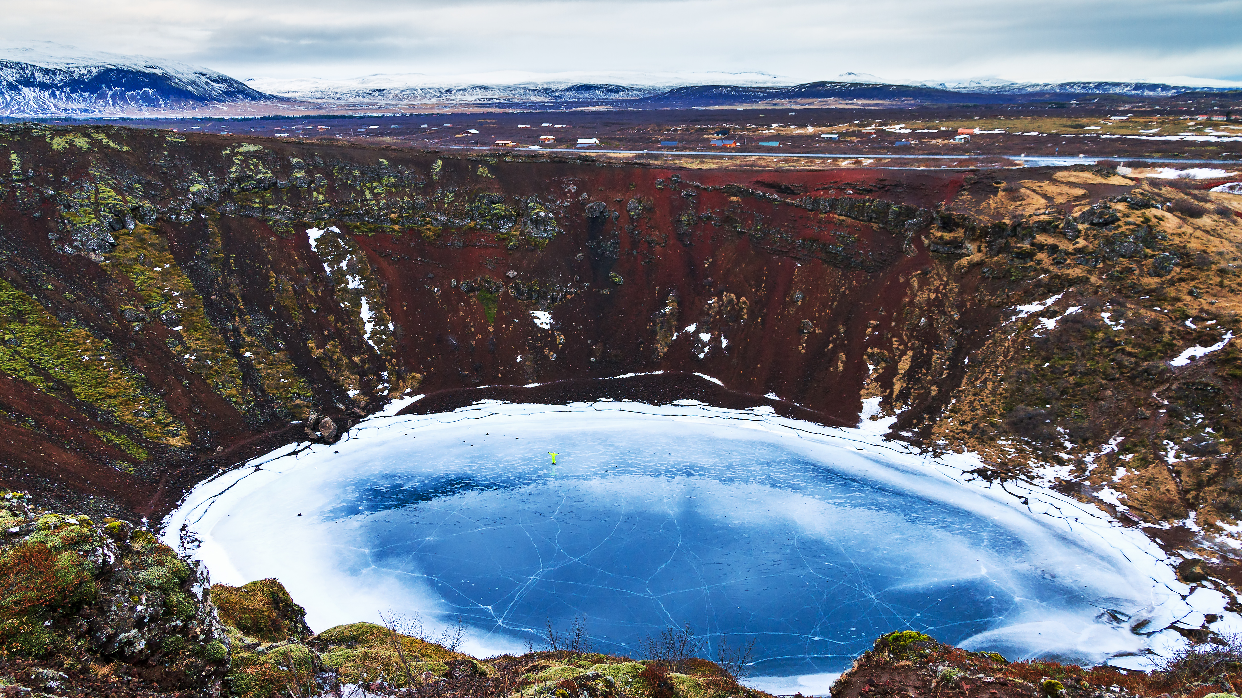

THE CHALLENGE OF NATURAL HAZARDS
Tectonics and Resources - Kerid Volcanic crater
List the possible impacts of a volcanic eruption.
Identify the different shapes of volcanoes.
What type of volcano is Kerid?
Draw a labelled diagram of a volcanoes structure.
How was Kerid volcano created?
Short term immediate responses to a volcanic eruption.
Identify volcanic hazards.
Describe how volcanoes can be managed as a long term response.

