Slide 1

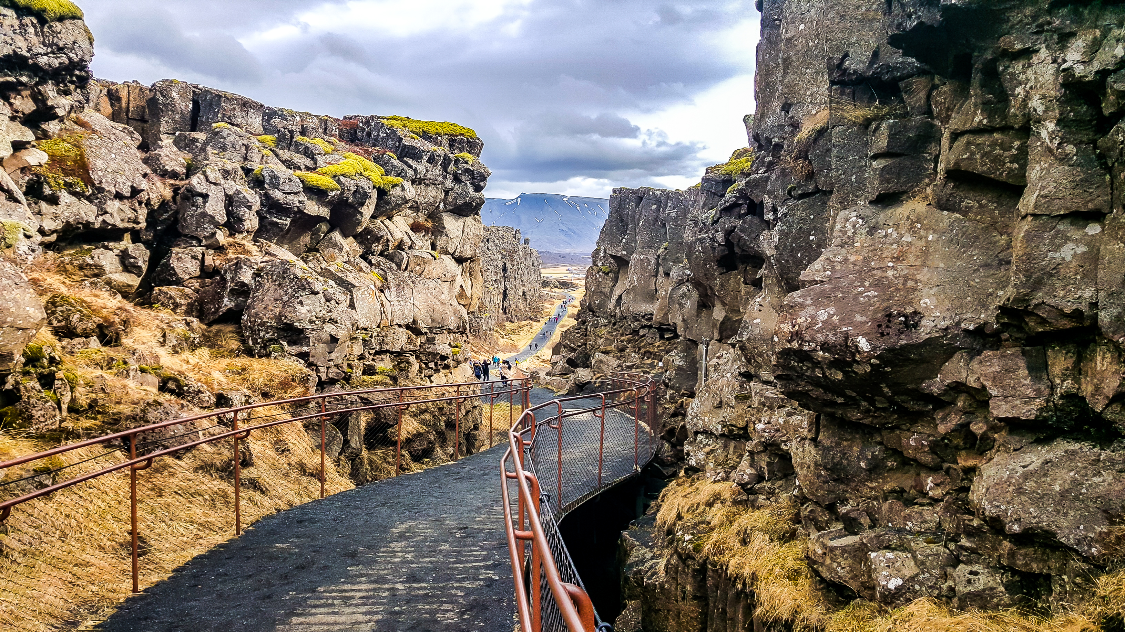
THE CHALLENGE OF NATURAL HAZARDS
Tectonics and Resources - Thingvellir National Park
Why is Thingvellir important?
Why do tectonic plates move?
What happens at a destructive plate boundary?
What is the difference between an oceanic and continent crust?
Draw and label a constructive plate boundary.
Which tectonic plates are moving away from each other at Thingvellir?
What happens at a constructive plate boundary?
What happens at a conservative plate boundary?

