Slide 1
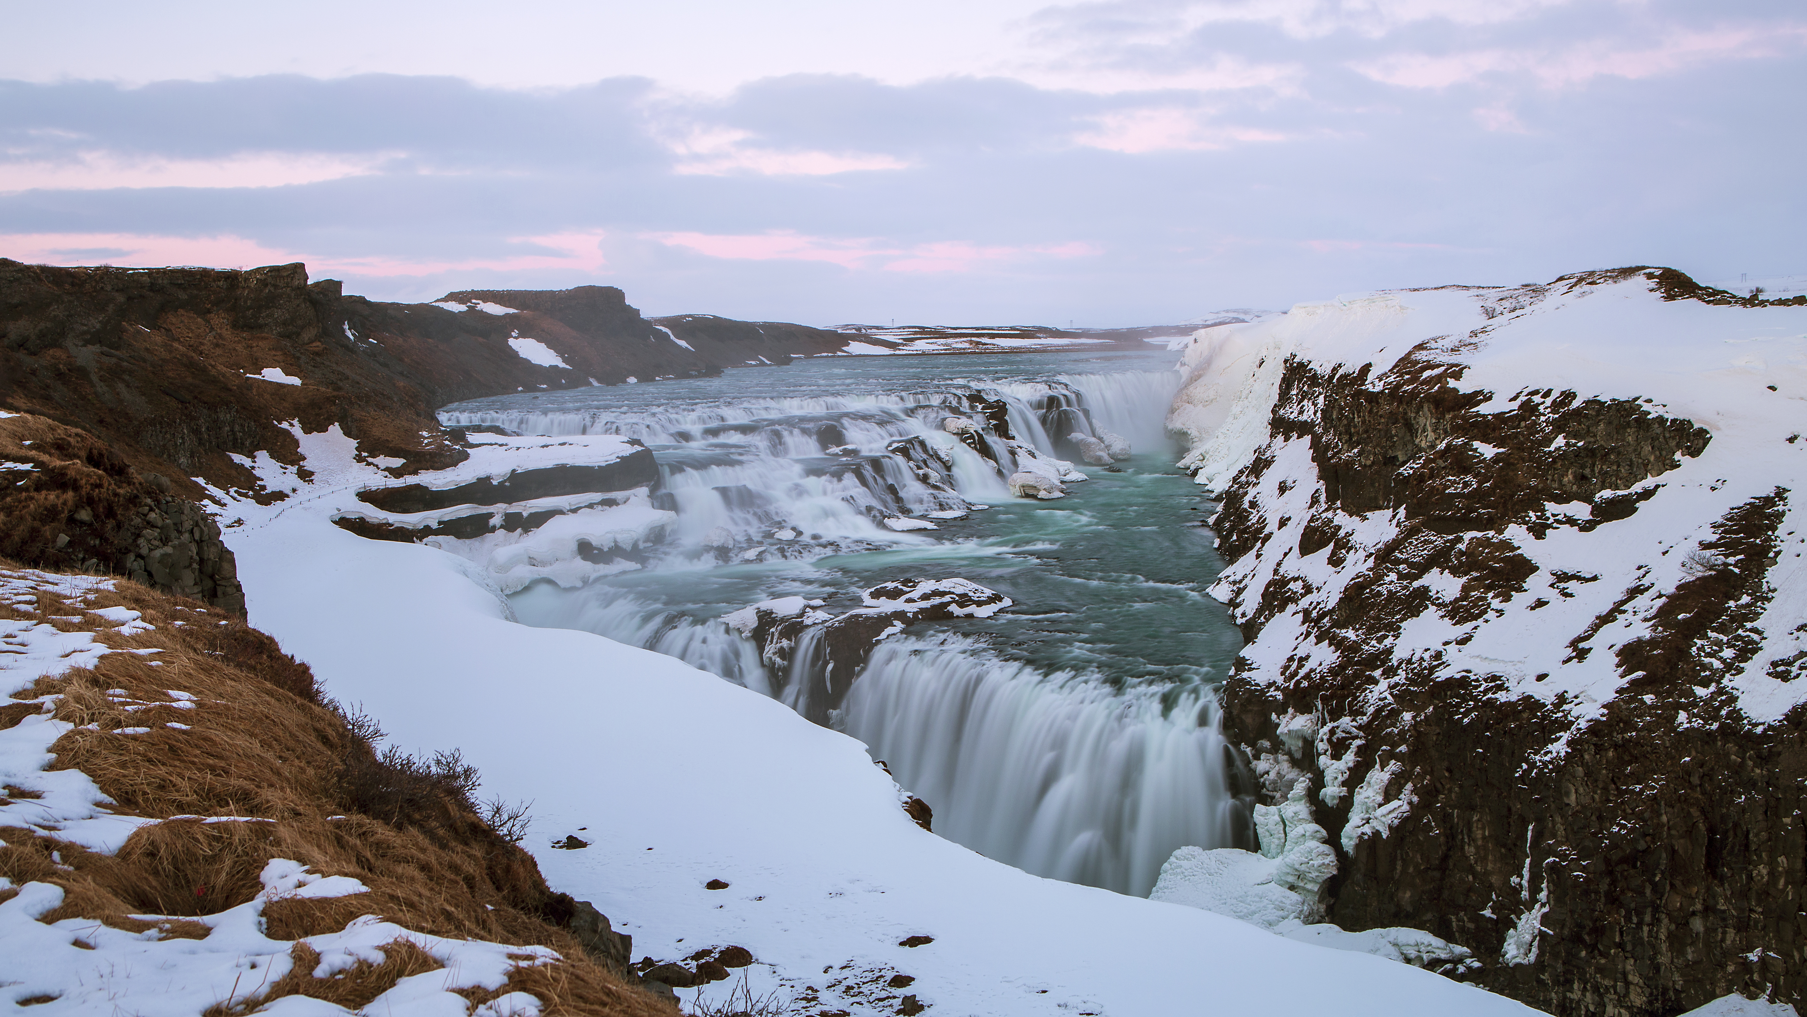

PHYSICAL LANDSCAPES RIVERS
Gullfoss
Name four types of river transportation.
Traction, saltation, suspension and solution.
Describe the location of Gullfoss waterfall.
Gullfoss is a waterfall located in the canyon of the Hvítá river in southwest Iceland.
Facts about Gullfoss waterfall.
Hvítá (White River) is a glacial river flowing southward straight from Langjökull (Long Glacier)
During summer the river flows at an average of 140 cubic meters per second. The waterfalls drop a total of 32 meters in two stages.
Name four types of river erosion.
Abrasion, attrition, hydraulic
action and solution.
Suggest one reason why a river would drop its load.
Deposition occurs whenever a river loses
energy and there is a decrease in velocity, such as when a river meets the sea (mouth).
Draw a field sketch of Gullfoss waterfall.
Explain the formation of a waterfall.
Waterfalls forms where there are layers hard rock on top of soft rock. The soft rock close to the surface under the hard rock is eroded faster by abrasion and hydraulic action. An overhang is
created. Over time, this gets bigger and eventually it collapses creating a waterfall. This process repeats deepening the plunge pool and the waterfall retreats upstream.
Explain the formation of a meander.
Rivers erode laterally, it forms large bends called meanders. The water erodes the river bank on the outside of the bend where the water flow has most energy. On the inside of the bend material is deposited. This continues to develop bends in the river known as meanders.

