Slide 1
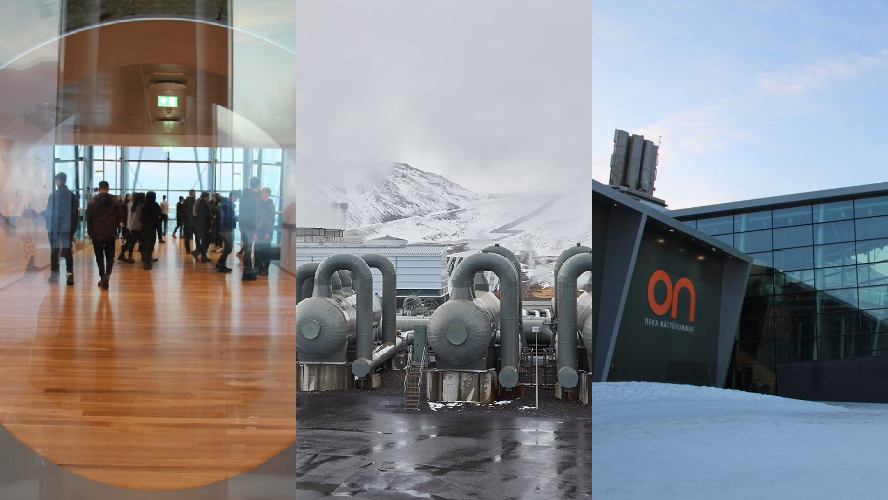

RESOURCE MANAGEMENT ENERGY
Hellisheidi Power Plant
The Hellisheidi power plant summary
Why has there been an increase in energy consumption?
What are fossil fuels? Give examples.
What is a natural resource?
What factors affect energy availability?
How does geothermal energy work in Iceland?
What is the difference between a renewable and non-renewable energy supply?
What strategies can be used to increase energy supply?

